Slide 1
Consumer Financial Protection Bureau: 2020 Tech Challenge
Team: Bryan Cash, Susan Fisher, Josef Hapli, Meredith Jones, Dan Petersen, Brian Rodrigue, Prema Roman

Slide 2
Executive Summary
Excella used the opportunity of the CFPB 2020 Tech Challenge to display our capabilities of creating an extensible machine learning solution to identify potential similar documents that would require further review
This solution applies to a business need at CFPB and is generalizable to other potential clients
Our solution involves an unsupervised learning model that can apply to specific documents and novel documents that were not in the training set
Next steps could include expanding the capabilities of the model to identify internal inconsistencies in submissions, vertically integrating the solution into the business process, promoting this new solution in blog posts, and showcases
Notes:
ASSIGNED TO: Josef

Slide 3



Agilists & Analysts
Susan Fisher, Josef Hapli, Brian Rodrigue
Team & Roles
Data Scientists & Engineers
Bryan Cash, Dan Petersen, Prema Roman
The Challenge Team utilized a standard DS scrum team plus two additional BAs to assist with data creation.
Scrum Master
Meredith Jones

Slide 4
The Problem We Are Solving
The team is addressing concerns at CFPB about inaccurate data being entered into the Customer Complaint database to support Identity Theft.
CFPB 2020
Challenge Background
Project Timing
Team Collaboration: Sep 21 – Sep 25
Tech Sprint: Sep 28 – Oct 2
Our goals
Using data science and Machine Learning, to innovate on new ways to detect strikingly similar documents sent to CFPB that could indicate inaccurate or duplicate data.
Notes:
ASSIGNED TO: Brian
Problem we are solving:
Recognize commonality between two different items in a data set as an potential indicator of inaccurate data

Slide 5






Why Undertake this Challenge?
Value to CFPB & The Fed Gov’t
Value to Excella
Improve Customer Complaint Process
Deepen Client Relationship
Help ensure the integrity of the Customer Complaint Portal by reducing inaccuracies
Engage with CFPB, as a current client, on a key strategic initiative
Streamline duplicate detection process
Showcase Capabilities
Automate current manual processes to easily identify duplicate submissions early
Demonstrate Excella capabilities that CFPB may not be currently leveraging
Ability to Scale
Visibility with Potential Clients
Provide CFPB with a solution that can scan millions of documents on demand
Display skills and capabilities to a wider audience that are not limited by NDAs

Slide 6

Our Approach
Leveraging Excella’s Agile Analysis, Development and Data Science skills, the team developed a simulated utility bill generator, which supplied training data for developing an unsupervised Machine Learning model capable of detecting similar documents in a large corpus.
Once trained, we created specious documents to test specific conditions to calculate the model’s “confidence score” that documents matched.
Notes:
ASSIGNED TO: Brian

Slide 7
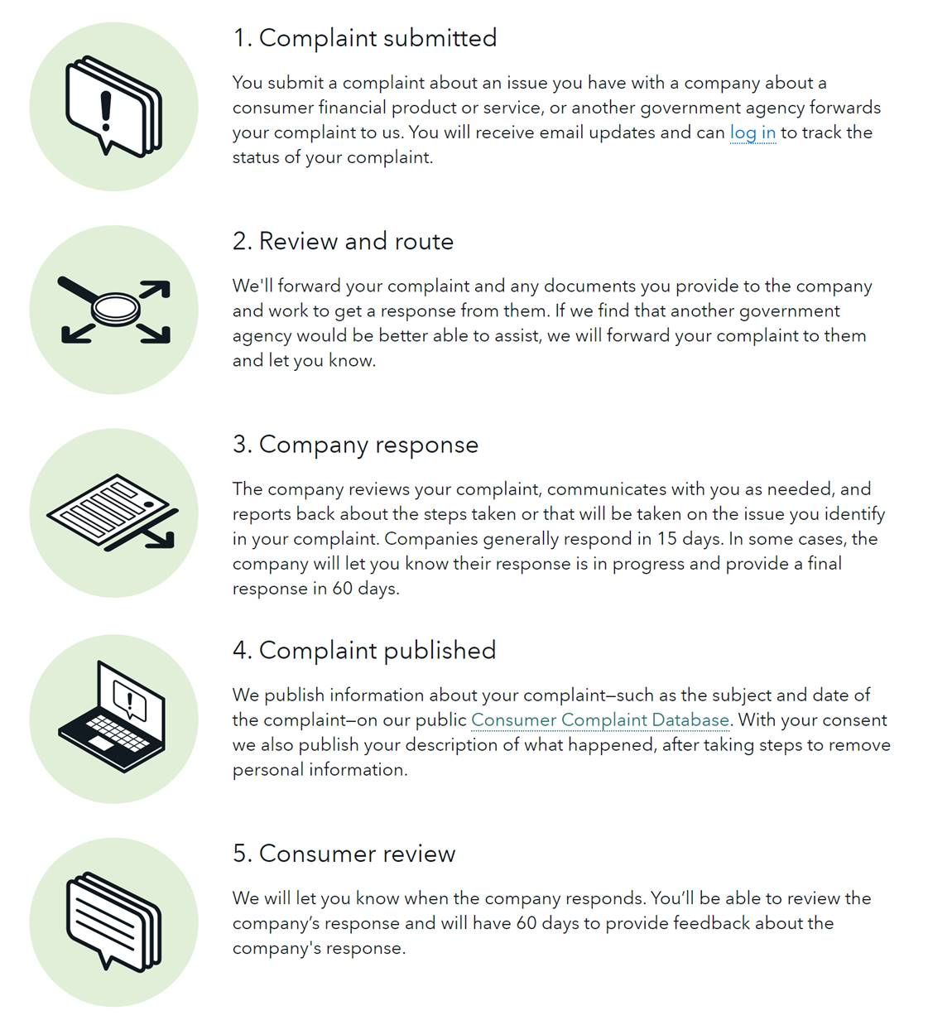
CFPB Customer Complaint Business Process
Through the CFPB Customer Complaint process, consumers' identity can be potentially stolen/abused using the customer complaints about adverse actions. Utility bills are often used as proof of identity or to establish an alternative address.

Slide 8
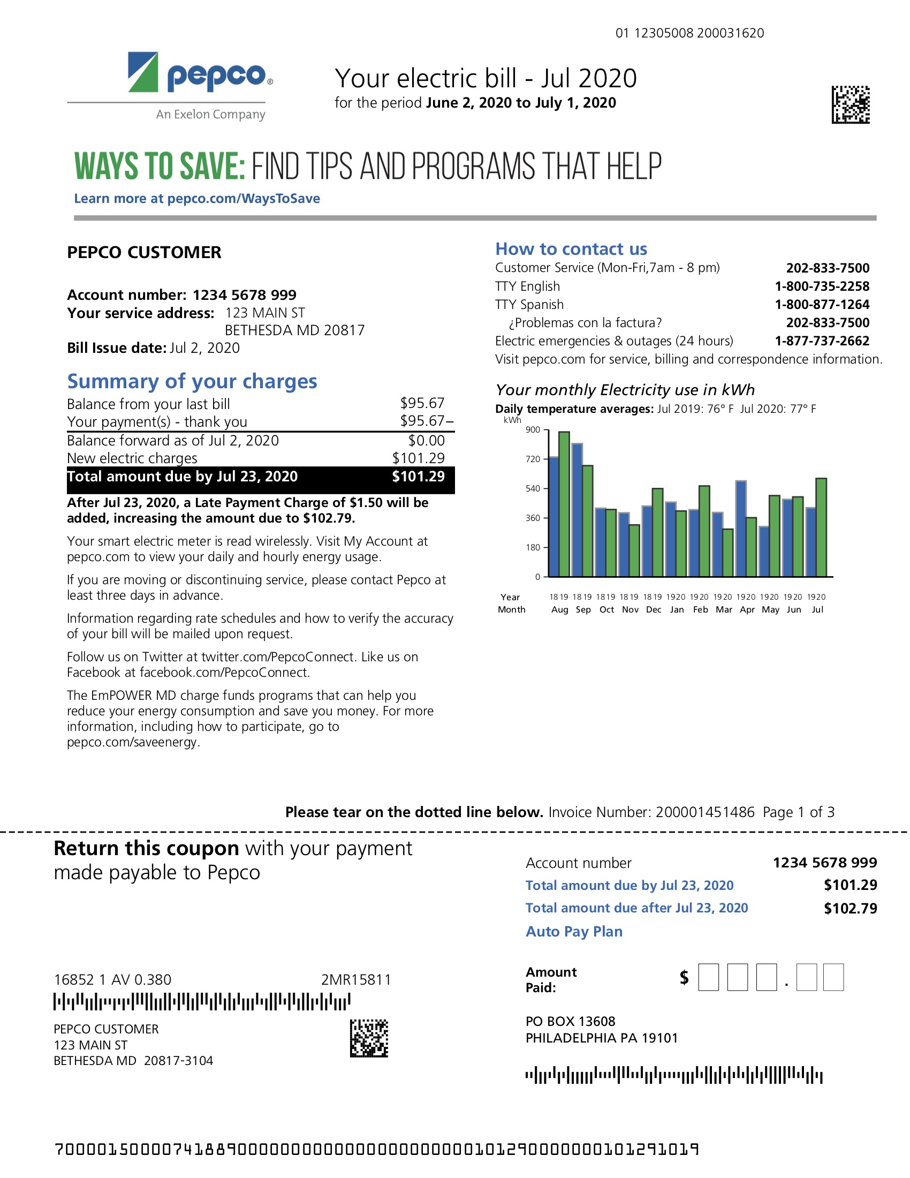
Common Ways Bills are Manipulated
John Smith
369 ELM ST
ROCKVILLE, MD 20862
JOHN SMITH
369 ELM ST
ROCKVILLE, MD 20862
Sample Bill
Manipulated Bill
Notes:
ASSIGNED TO: Josef
Include call outs from criteria A-F

Slide 9
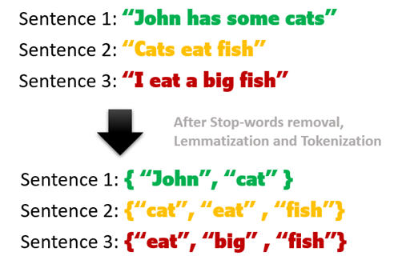
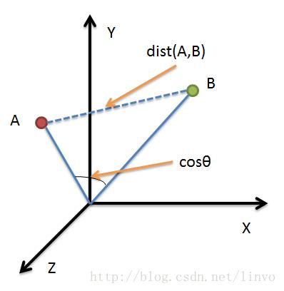
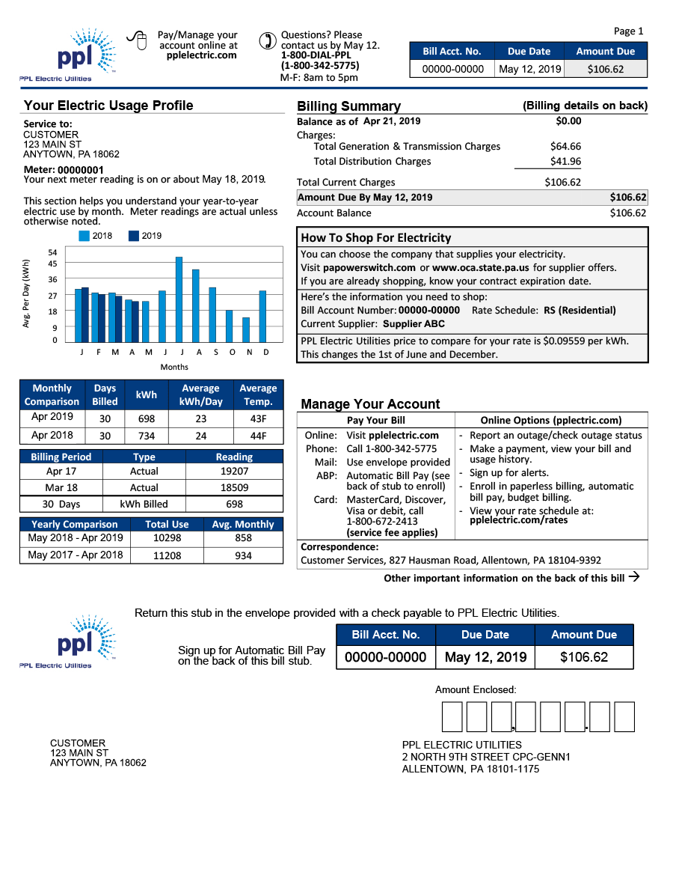
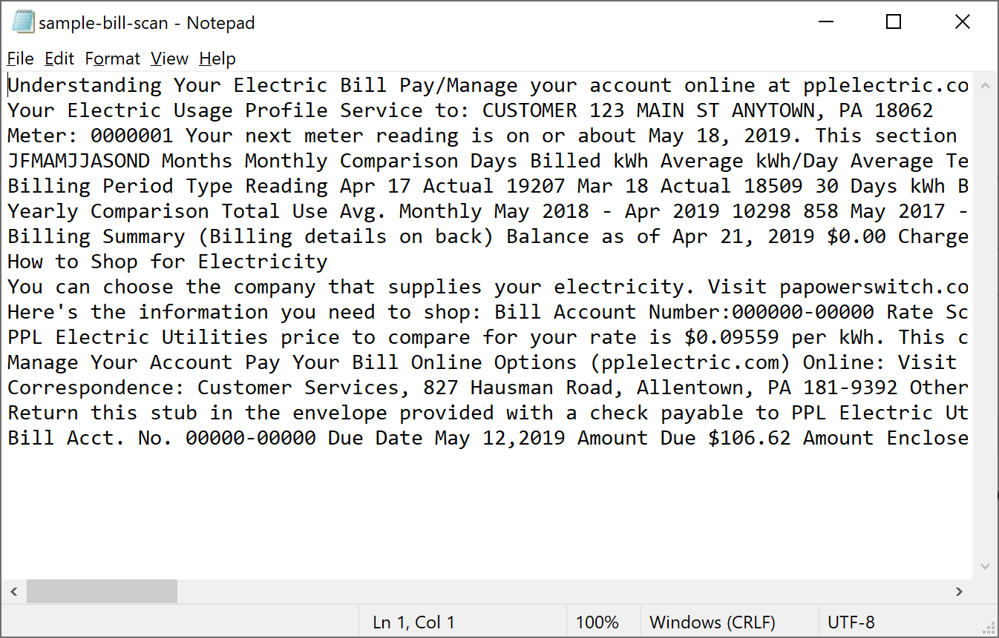
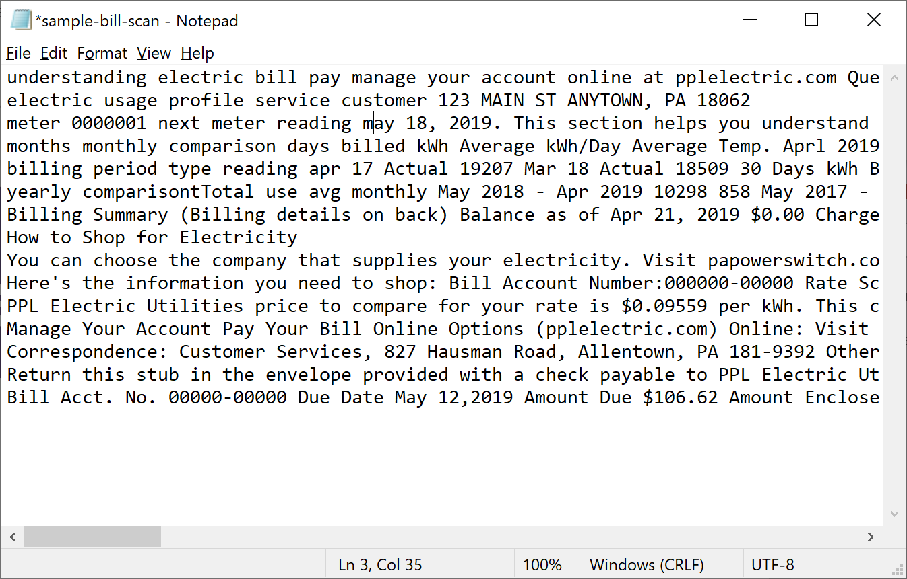
Data Discovery and Extraction
Discovery
Gather sample documents for analysis
Extraction
Direct text scraping or image OCR, depending on file type
Tag & Clean
Lowercasing, lemmatization, stop word removal
NLP
Word tokenization, TF-IDF document vectorization
Relationships
Document-document matrix, cosine similarity
Notes:
ASSIGNED TO: Brian

Slide 10
1. Find template documents
The Technical Process
2. Extract text
We extracted text from pdf documents and saved the data to csv files.
3. Auto generate a large dataset for model training
Using the Faker python library, along with extracted text from sample utility bills, the team synthesized 2500 realistic documents to provide training data for our unsupervised model.

Slide 11
Create Test Data for Matching
We duplicated and modified 15 existing documents to create similar documents. This consisted of changes to metrics and user demographics.
The
Technical
Process
TF-IDF
This is a form of document vectorization that emphasizes less-common words, enabling easier detection of document similarity.
Cosine Similarity Testing
The similarity of a given document-document pair can be computed by finding the cosine of the angle between the document vectors. Larger values indicate greater similarity between the documents.

Slide 12
Measuring Similarity Between Documents
The "constant" data is isolated; variable text is highlighted and compared to other documents to identify differences. If a dimension matches, it is flagged for further review.
Dimensions:
A. Name (No Match)
B. Account Number (Match)
C. Address (Match)
D. Address very close OR same address, different apt (No Match)
E. Invoice Number (Match)
F. Metrics: Charges, Amount Due, Usage, Payments (Match)
A
B
C
F
F
E
B
F
A, C
Constant
Variable

Slide 13
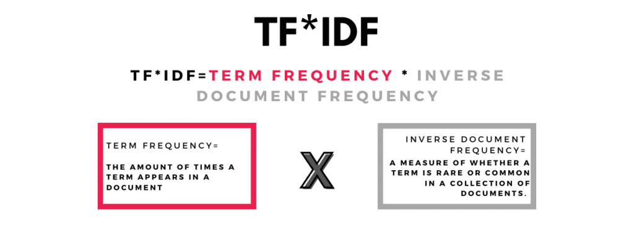
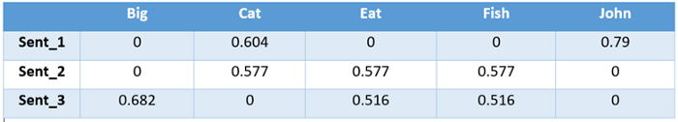
Measuring Similarity Between Documents

Slide 14
Measuring Similarity Between Documents
Cosine Similarity
Each document is represented as a high-dimensional vector (TF-IDF vector)
For a given document-document pair, the cosine of the angle between the vectors (a scalar) represents their similarity
All possible document-document pairs are computed and organized into a document-document similarity matrix.
A threshold is applied to the similarity matrix to identify documents of interest

Slide 15




Our Outcomes
Recall Score of 100%
When run against our validation set, our model accurately captured all modified documents, without capturing false positives.
Models Functioned Against Known & Unknown Documents
Our models tested well against large collections of very similar documents and documents with varying formats
Updated Common Infrastructure
We tested our code against the Sprout-ML container and updated the common code base to make future ML tech challenges easier
Notes:
Dimensions:
A. Name (No Match)
B. Account Number (Match)
C. Address (Match)
D. Address very close OR same address, different apt (No Match)
E. Invoice Number (Match)
F. Metrics: Charges, Amount Due, Usage, Payments (Match)

Slide 16
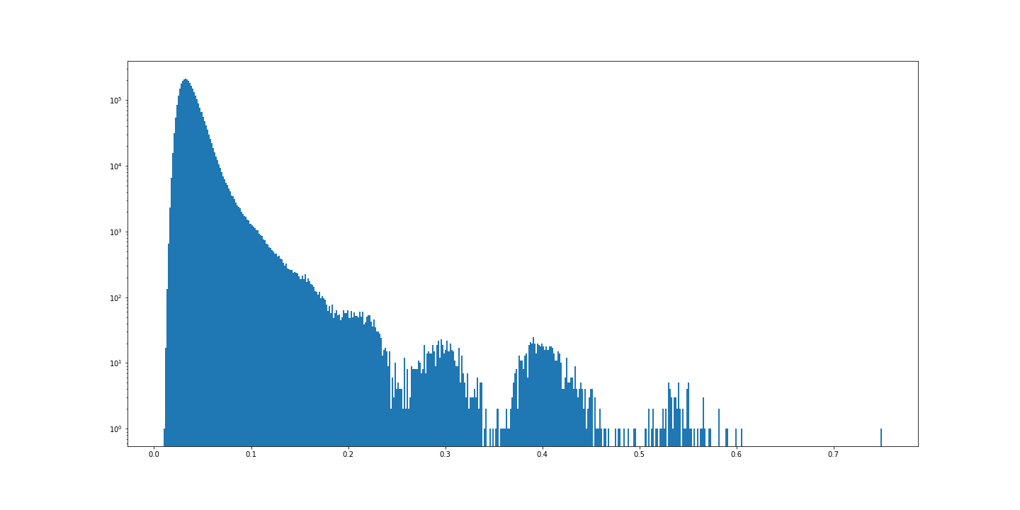
Model Results
Document pair cosine similarity distribution
2500 documents
2500 unique base documents
15 target documents
Target documents appear at high-similarity tail of distribution, mixed with a few non-target documents.
Maximum
threshold for
100% recall
(44% precision)
Frequency
(Logarithmic scale!)
Cosine similarity

Slide 17
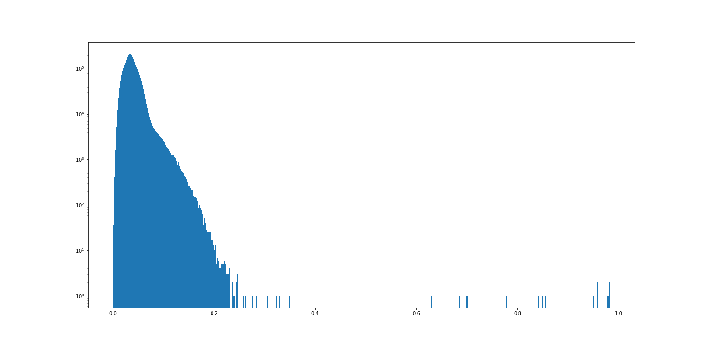
Model Results
Document pair cosine similarity distribution
2500 documents
Single base document
15 target documents
Maximum
threshold for
100% recall
(100% precision)
Frequency
(Logarithmic scale!)
Target documents appear at high-similarity tail of distribution, no non-target documents.
Cosine similarity

Slide 18
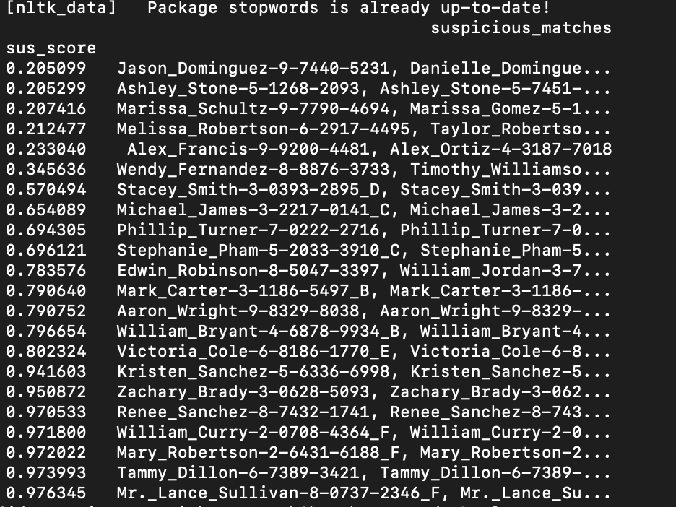
Determining Threshold
Setting threshold for risk score.
Screenshot on the side displays a visual from development. All of the rows from Wendy Fernandez to Lance Sullivan were true positives. Wendy Fernandez was also a very weak true positive, as we wanted to see how low the scores would be for our weak matches.
As we can see, there is a large gap between Alex Francis and Wendy Fernandez. This helped with determining a clear threshold.

Slide 19
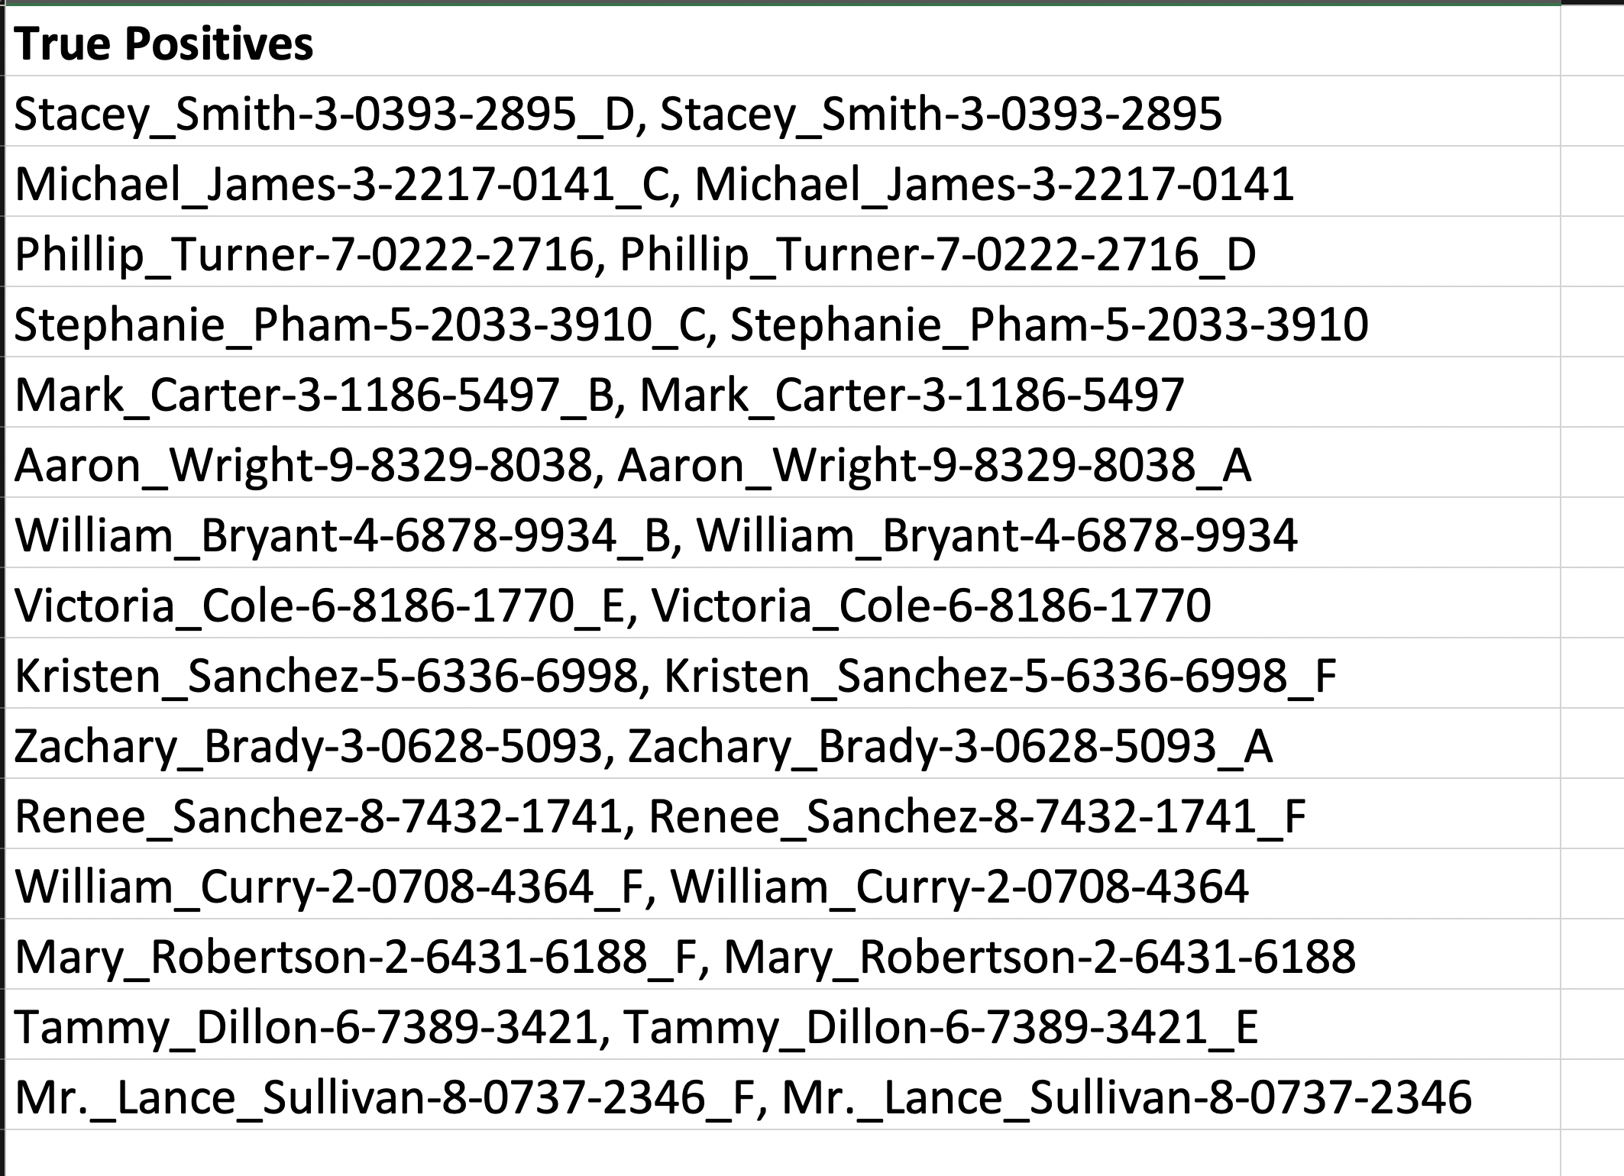
Model Output

Slide 20
Sprout-ML
A data science toolbox that enables teams to efficiently bootstrap new machine learning projects.
No need to start from scratch – most common tools needed for ML projects already built in
Only change what's needed for your specific project
Using docker eliminates the issues between different operating systems
Ability to spin up containers, but not integrate with full TCP CI/CD pipelines
Notes:
ASSIGNED TO: Josef
OUTLINE:
Exec Summary
Team & Roles
Challenge Background, Timing
Value of Challenge: to Excella, to Clients
Solution Approach
Steps Taken
Outcomes

Slide 21
Leveraged and Enhanced Sprout-ML
Containerized the ML application using Sprout-ML
Added code to training pipeline script
Slight modifications to requirements.txt, Dockerfile and docker-compose files
Added helper functions to store model results
Provide the ability to version control results in order to be able to compare different models / different datasets
Option to store the files in the file system or in a S3 bucket
Notes:
ASSIGNED TO: Josef
OUTLINE:
Exec Summary
Team & Roles
Challenge Background, Timing
Value of Challenge: to Excella, to Clients
Solution Approach
Steps Taken
Outcomes

Slide 22
DEMO

Slide 23
Expand Model Capability
Enhance the model to be able to catch more sophisticated cases.
Ideal Next Steps
Blog Post Ideas
Generating training/validation data
Common patterns in starting Data Science projects
Identifying similar documents
Identifying Fraud in supporting docs
Attacking DS problems
ExcellaLabs Showcase
Expand application to cover more of the process

Slide 24

Questions?

Slide 25
THANK YOU!

Slide 27





























Enjoy these usable icons! If you need to edit, please ungroup.

